Slide 1
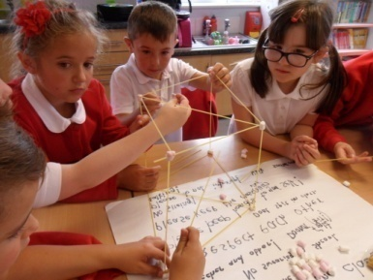
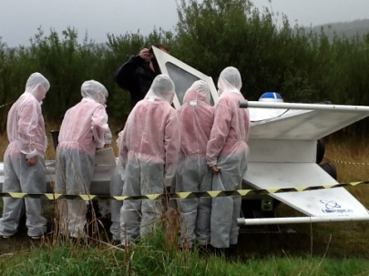
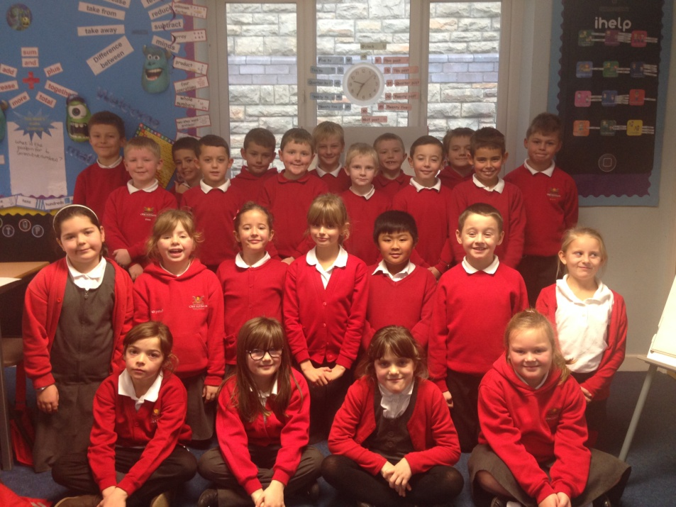
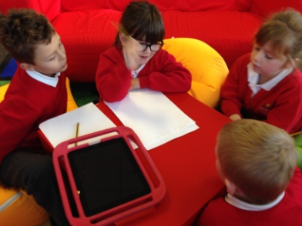
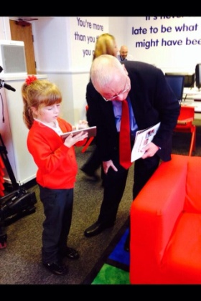
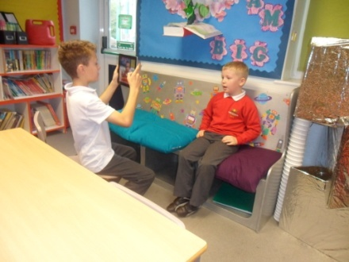
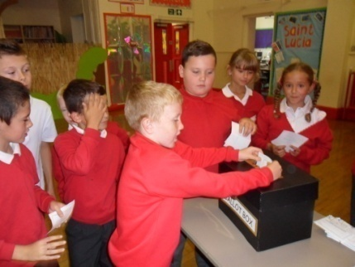
Hello From
Dosbarth Gwyn

Slide 2
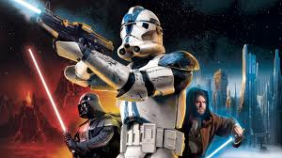
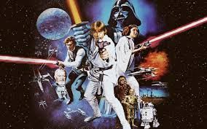
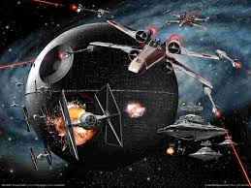
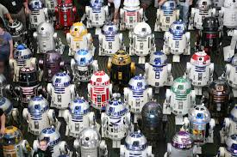
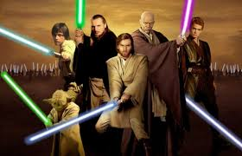
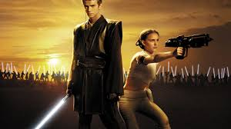
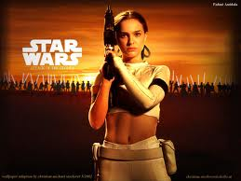
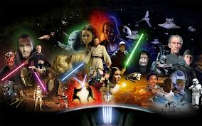
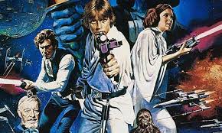
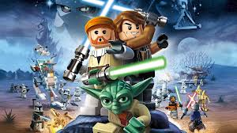
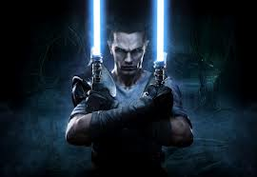
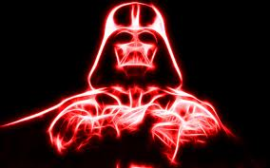
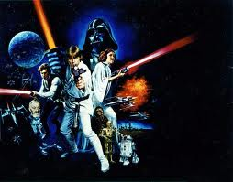
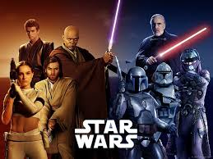
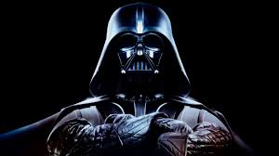
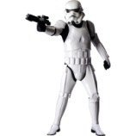
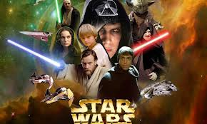
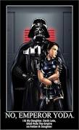
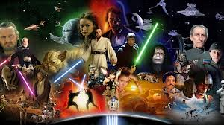
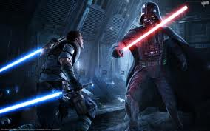
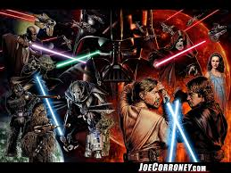
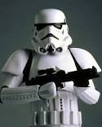
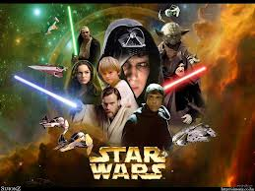
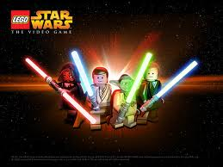
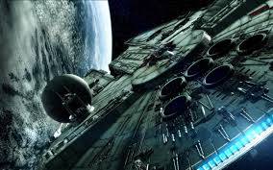
Who are we?
Come on an adventure with us!

Slide 3
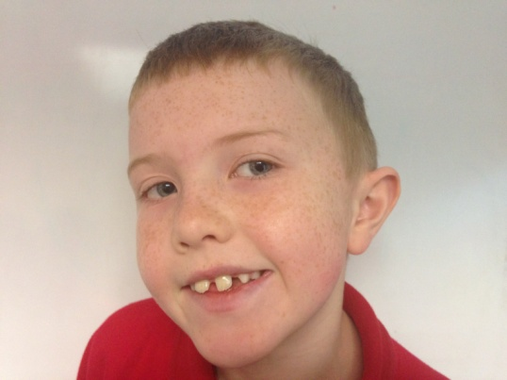
Pupil Profile
Finley Jones
Name: Finley Jones
Age: eight
Eye colour: blue
Hair colour: blonde
Town: Cwmclydach
Teacher: Miss Howells
Class: Dosbarth Gwyn
Height: 115cm
Foot size: one
Birthday: 7th August
Favourite colour: green
Favourite food: pasta
Hobbies: swimming
Best friends: Harvey Jones

Slide 4
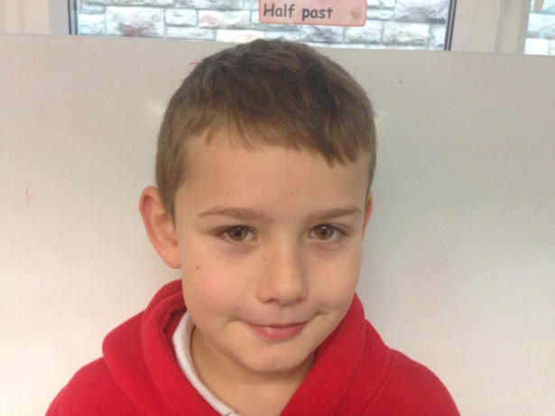
Pupil Profile
Harvey Jones
Name: Harvey Jones
Age: eight
Eye colour: green
Hair colour: brown
Town: Cwmclydach
Teacher: Miss Howells
Class: Dosbarth Gwyn
Height: 126cms
Foot size:3
Birthday:5th September
Favourite colour: blue
Favourite food: cooked dinner
Hobbies: rugby
Best friends: Harvey Hawkins

Slide 5
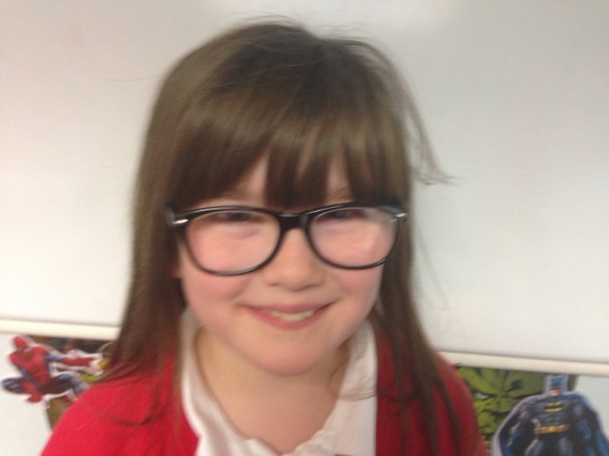
Pupil Profile
Lily Smith
Name: Lily Smith
Age: eight
Eye colour: blue
Hair colour: brown
Town: Blaenclydach
Teacher: Miss Howells
Class: Dosbarth Gwyn
Height: 120 cms
Foot size: eleven
Birthday: 10th May
Favourite colour: red
Favourite food: pizza
Hobbies: ballet
Best friends: holly Jones

Slide 6
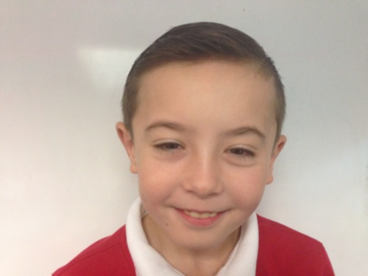
Pupil Profile
Steele Williams
Name: Steele Williams
Age: eight
Eye colour: brown
Hair colour: brown
Town: Cwmclydach
Teacher: Miss Howells
Class: Dosbarth Gwyn
Height: 132cms
Foot size: one
Birthday: 24 January
Favourite colour: red
Favourite food: steak
Hobbies: riding motor bikes
Best friends: Jadyn and Ethan

Slide 7
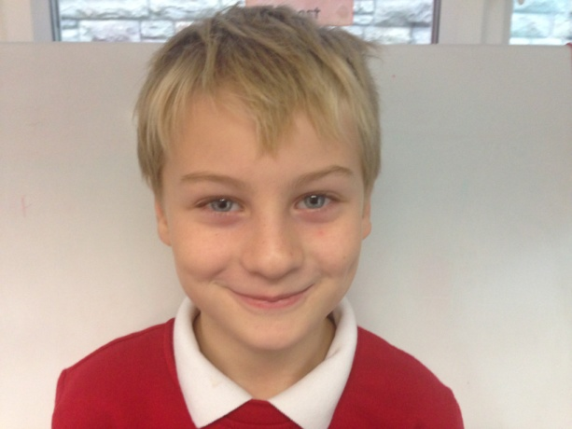
Pupil Profile
Logan Williams
Name: Logan Williams
Age: eight
Eye colour: blue
Hair colour: blonde
Town: Tonypandy
Teacher: Miss Howells
Class: Dosbarth Gwyn
Height: 126cm
Foot size: 12
Birthday: 8th November
Favourite colour: blue
Favourite food: McDonalds
Hobbies: rugby
Best friends: Harvey Hawkins

Slide 8
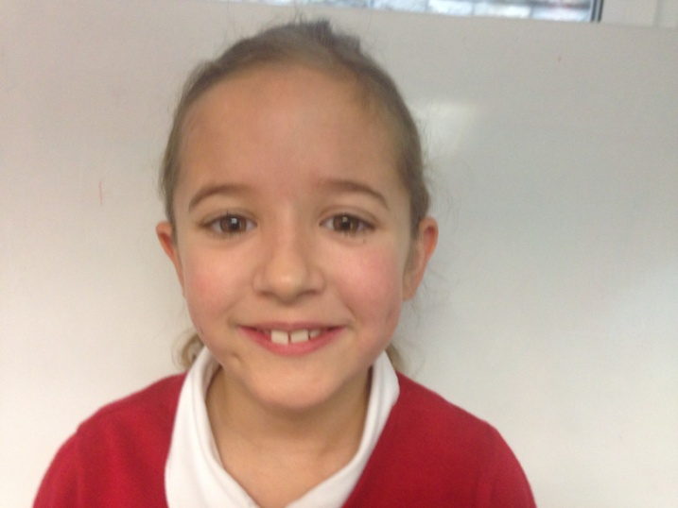
Pupil Profile
Amelia Jones
Name: Amelia Jones
Age: eight
Eye colour: brown
Hair colour: brown
Town: Cwmclydach
Teacher: Miss Howells
Class: Dosbarth Gwyn
Height: 123cms
Foot size: 12
Birthday: 9th April
Favourite colour: orange
Favourite food: cooked dinners
Hobbies: karate
Best friends: Holly

Slide 9
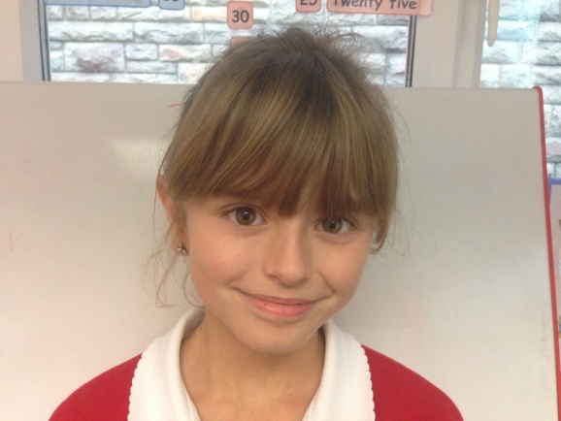
Pupil Profile
Name: Holly Jones
Age: eight
Eye colour: brown
Hair colour: brown
Town: Cwmclydach
Teacher: Miss Howells
Class: Dosbarth Gywn
Height: 117cms
Foot size: 1
Birthday: 27 December
Favourite colour: red
Favourite food: cooked dinner
Hobbies: playing on iPad
Best friends: Millie Jones
Holly Jones

Slide 10
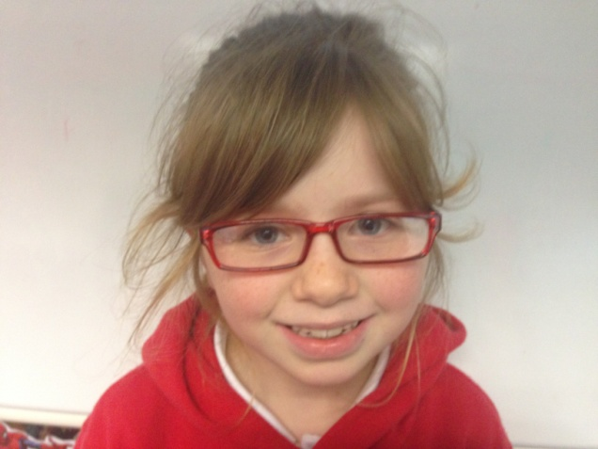
Pupil Profile
Crystal Llewellyn
Name: Crystal Llewellyn
Age: eight
Eye colour: blue
Hair colour: strawberry blonde
Town: Cwmclydach
Teacher: Miss Howells
Class: Dosbarth Gwyn
Height: 126cms
Foot size: 13
Birthday: 17th September
Favourite colour: red
Favourite food: cooked dinner
Hobbies: brownies
Best friends: Callie and ffion

Slide 11
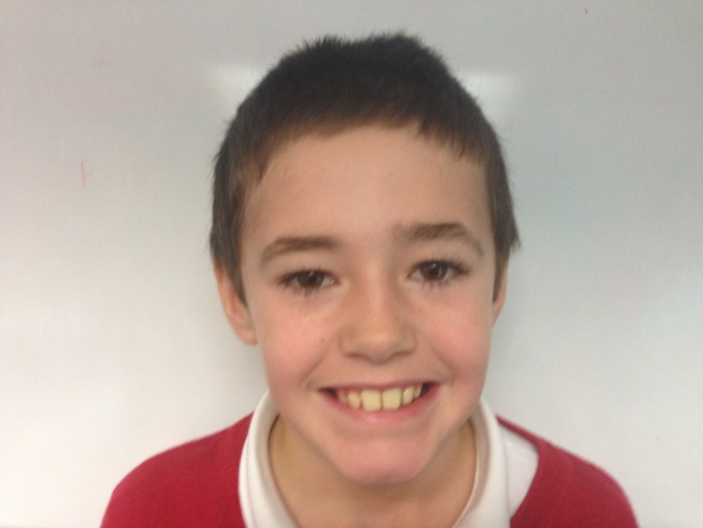
Pupil Profile
Joe Povey
Name: Joe Povey
Age: eight
Eye colour: brown
Hair colour: black
Town: Cwmclydach
Teacher: Miss Howells
Class: Dosbarth Gwyn
Height: 127cms
Foot size: 2
Birthday: 12th September
Favourite colour: red
Favourite food: Mcdonalds
Hobbies: swimming
Best friends: Jenson

Slide 12
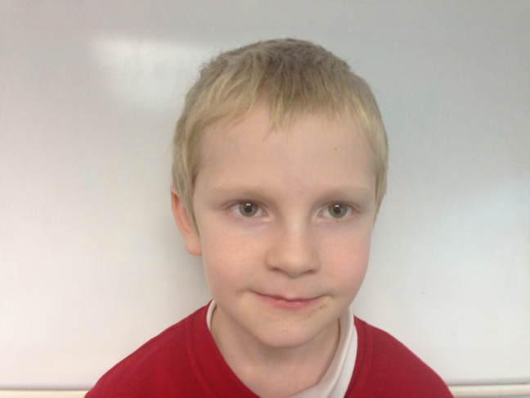
Pupil Profile
Darcy
Homer
Name: Darcy Homer
Age: eight
Eye colour: green/blue
Hair colour: blonde
Town: Cwmclydach
Teacher: Miss Howells
Class: Dosbarth Gwyn
Height: 123cms
Foot size: 12
Birthday: 2005
Favourite colour: red/yellow
Favourite food: spaghetti
Hobbies: playing
Best friends: chad

Slide 13
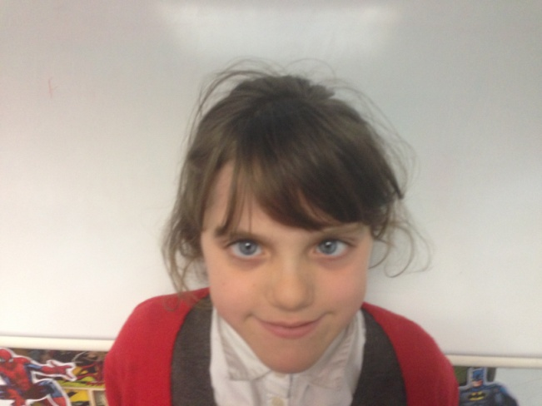
Pupil Profile
Seren Jones
Name: SERen JONES
Age: EIGHT
Eye colour: blue
Hair colour: brown
Town: CLYDACH VALE
Teacher: Miss Howells
Class: Dosbarth GWYN
Height: 125cms
Foot size: 11
Birthday: 16TH MARCH
Favourite colour: DARK PINK
Favourite food: SUNDAY DINNER
Hobbies: SKIPPING, ACTING, SINGING
Best friends: CRYSTAL

Slide 14
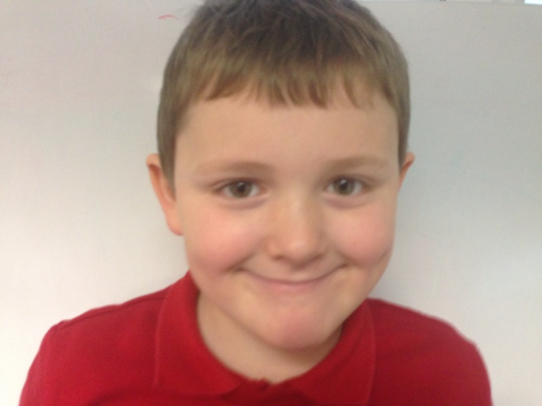
Pupil Profile
Aaron Sampson
Name: Aaron Sampson
Age: eight
Eye colour: blue
Hair colour: brown
Town: Williamstown
Teacher: Miss Howells
Class: Dosbarth Gwyn
Height: 125cms
Foot size: one
Birthday: 18th September
Favourite colour: blue
Favourite food: pizza
Hobbies: playing video games
Best friends: steele and noah

Slide 15
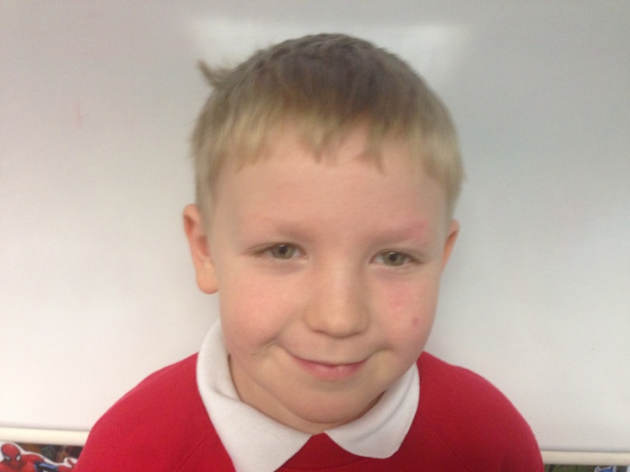
Pupil Profile
ETHAN THOMAS
Name: Ethan Thomas
Age: eight
Eye colour: green
Hair colour: blonde
Town: Cwmclydach
Teacher: Miss Howells
Class: Dosbarth Gwyn
Height: 110cms
Foot size: 1
Birthday: 6th March
Favourite colour: red
Favourite food: salad
Hobbies: rugby
Best friends: Mckenzie

Slide 16
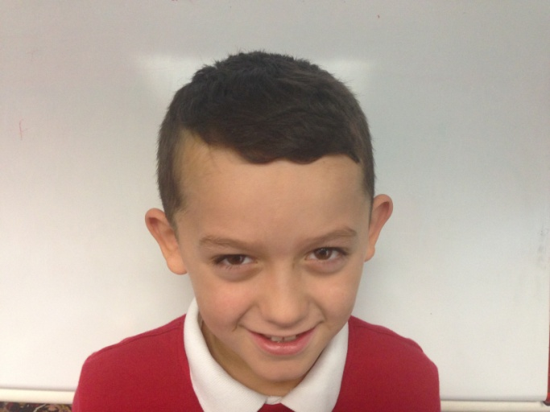
Pupil Profile
McKenzie Davies
Name: Mckenize Davies
Age: eight
Eye colour: brown
Hair colour: brown
Town: Cwmclydach
Teacher: Miss Howells
Class: Dosbarth Gwyn
Height: 123cms
Foot size: 13
Birthday: 16th February
Favourite colour: red
Favourite food: KFC
Hobbies: football
Best friends: Harvey

Slide 17
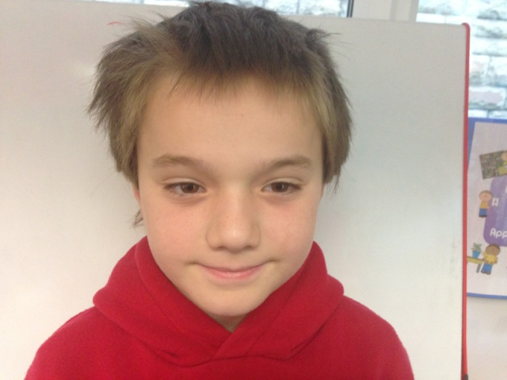
Pupil Profile
Shay Owen
Name: shay owen
Age: eight
Eye colour: brown
Hair colour: brown
Town: Cwmclydach
Teacher: Miss Howells
Class: Dosbarth Gwyn
Height: 123 cms
Foot size: 3.5
Birthday: 24th December
Favourite colour: red
Favourite food: sausage and mash
Hobbies: riding my bicycle
Best friends: frankie

Slide 18
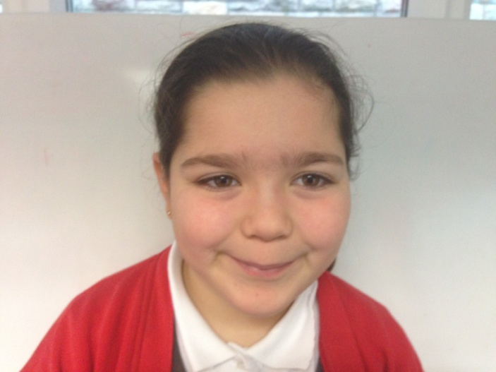
Pupil Profile
Aliyah clement
Name: Aliyah Clement
Age: nine
Eye colour: brown
Hair colour: brown
Town: Cwmclydach
Teacher: Miss Howells
Class: Dosbarth Gwyn
Height: 130cms
Foot size: one
Birthday: 8th December
Favourite colour: red
Favourite food: pizza and chips
Hobbies: sports
Best friends: Laihla

Slide 19
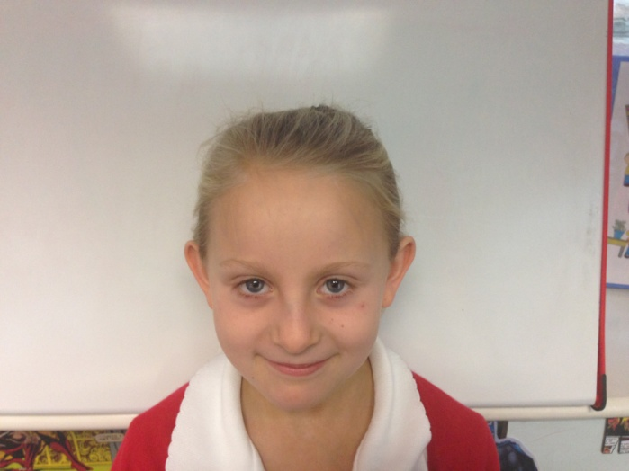
Pupil Profile
Callie Murphy
Name: Callie Murphy
Age: eight
Eye colour: blue
Hair colour: blonde
Town: Blaenclydach
Teacher: Miss Howells
Class: Dosbarth Gwyn
Height: 118cms
Foot size: 13
Birthday: 1st September
Favourite colour: blue
Favourite food: McDonalds
Hobbies: gymnastics, swimming
Best friends: Erin

Slide 20
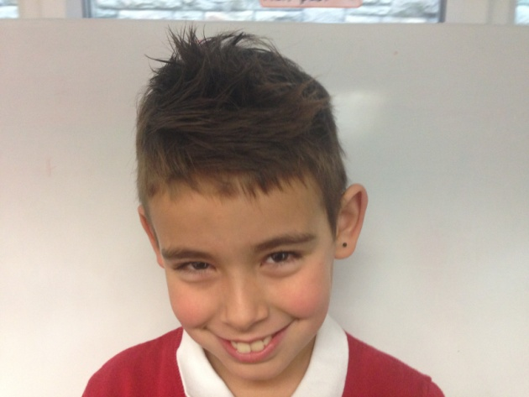
Pupil Profile
Frankie Weaver
Name: Frankie Weaver
Age: eight
Eye colour: brown
Hair colour: brown
Town: Cwmclydach
Teacher: Miss Howells
Class: Dosbarth Gwyn
Height: 128cms
Foot size: 13
Birthday: 10th February
Favourite colour: blue
Favourite food: steak and chips
Hobbies: rugby and football
Best friends: Shay Owen

Slide 21
Pupil Profile
Ryand Gaya
Name: Ryand Gaya
Age: eight
Eye colour: black
Hair colour: black
Town: Cwmclydach
Teacher: Miss Howells
Class: Dosbarth Gwyn
Height: 138cms
Foot size: one
Birthday: 3rd May
Favourite colour: blue
Favourite food: sausage
Hobbies: watching television
Best friends: Ethan

Slide 22
Pupil Profile
Callum Stacey
Name: Callum Stacey
Age: nine
Eye colour: brown
Hair colour: brown
Town: Cwmclydach
Teacher: Miss Howells
Class: Dosbarth Gwyn
Height: 114cms
Foot size: 3
Birthday: 18th November
Favourite colour: blue
Favourite food: pizza
Hobbies: playing on my tablet
Best friends: Ethan

Slide 23
Pupil Profile
Shay James
Name: shay james
Age: eight
Eye colour: blue
Hair colour: black/brown
Town: Cwmclydach
Teacher: Miss Howells
Class: Dosbarth Gwyn
Height: 124cms
Foot size: 13
Birthday: 18th May
Favourite colour: blue
Favourite food: pasta
Hobbies: video games
Best friends: Callum Stacey

Slide 24
Pupil Profile
Laihla Osborne
Name: Laihla osborne
Age: eight
Eye colour: brown
Hair colour: brown
Town: Cwmclydach
Teacher: Miss Howells
Class: Dosbarth Gwyn
Height:126cms
Foot size: one
Birthday: 22nd December
Favourite colour: white
Favourite food: sunday dinner
Hobbies: playing with my sister
Best friends: Aliyah and callie

Slide 25
Pupil Profile
Olivia Jones
Name: Olivia Jones
Age: eight
Eye colour: blue
Hair colour: blonde
Town: Cwmclydach
Teacher: Miss Howells
Class: Dosbarth Gwyn
Height: 113cms
Foot size: 13
Birthday: 17th July
Favourite colour: pink
Favourite food: Sunday dinner
Hobbies: horse riding
Best friends: Laihla

Slide 26
Pupil Profile
Jayden Morgan
Name: Jayden Morgan
Age: eight
Eye colour: blue
Hair colour: brown
Town: Cwmclydach
Teacher: Miss Howells
Class: Dosbarth Gwyn
Height: 138cms
Foot size: 3
Birthday:
Favourite colour: blue
Favourite food: Sunday dinner
Hobbies: football and motorbikes
Best friends: Finley and Ryand

Slide 27
Pupil Profile
Erin Weeks
Name: Erin Weeks
Age: eight
Eye colour: blue
Hair colour: blonde
Town: Cwmclydach
Teacher: Miss Howells
Class: Dosbarth Gwyn
Height: 110cms
Foot size: 12
Birthday: 6th February
Favourite colour: pink
Favourite food: chicken nuggets
Hobbies: play outside, riding my bike
Best friends: Olivia, Amelia

Slide 28
Pupil Profile
Gavin Parry
Name: Gavin Parry
Age: nine
Eye colour: blue
Hair colour: blonde
Town: Cwmclydach
Teacher: Miss Howells
Class: Dosbarth Gwyn
Height: 123cms
Foot size: 2
Birthday: 9th December
Favourite colour: blue
Favourite food: salad
Hobbies: playing with my brother
Best friends: Shay Owen

Slide 29
Pupil Profile
Jadyn Thomas
Name: Jadyn Thomas
Age: eight
Eye colour: green
Hair colour: ginger
Town: Cwmclydach
Teacher: Miss Howells
Class: Dosbarth Gwyn
Height: 115cms
Foot size: two
Birthday: 21st August
Favourite colour: blue
Favourite food: pizza
Hobbies: football
Best friend: Ethan

Slide 30
Pupil Profile
Chad Gifford
Name: Chad Gifford
Age: eight
Eye colour: brown
Hair colour: brown
Town: Cwmclydach
Teacher: Miss Howells
Class: Dosbarth Gwyn
Height: 121 cms
Foot size: one
Birthday: 27th March
Favourite colour: blue
Favourite food: fish and chips
Hobbies: xbox, reading
Best friends: Finley

Slide 31
Pupil Profile
Miss Howells
Name: Miss Howells
Age: 5x9-3
Eye colour: blue
Hair colour: brown
Town: Llwynypia
Teacher: Mr Dacey
Class: Dosbarth Gwyn
Height: 5ft 4in
Foot size: 6
Birthday: 18th September
Favourite colour: blue
Favourite food: toast with butter
Hobbies: reading, brownies, watching Doctor Who
Best friend: Mrs Edwards

